Slide 1
Signals, Encoding and Modulation
Gihan Dias
CS2032 – Principles of Computer Communication
with slides by Sulochana Sooriyaarachchi
2017 Batch – Jan 2019

Slide 2
Outcomes
  After successful completion of this lesson you will be able t0:
  Identify and compare different techniques for encoding data into signals

Slide 3
Encoding and Modulation
Encoding takes a digital or an analog signal and converts it to a form suitable for sending on a wire or a fibre
  Baseband
Modulation takes a digital or an analog signal and modifies a carrier signal with it
  Passband (also called Broadband)

Slide 4
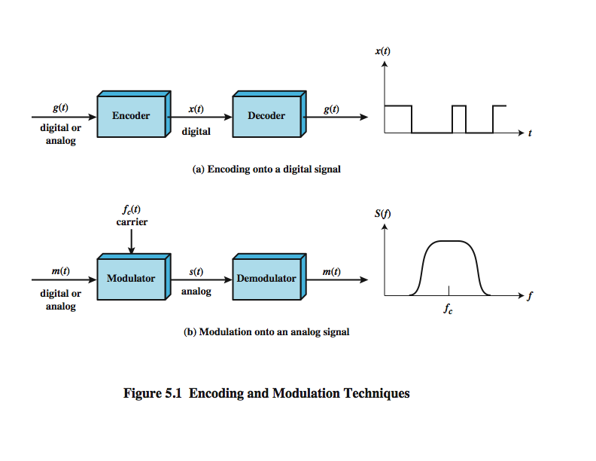
Encoding and Modulation

Slide 5
Forms of Encoding and Modulation
Digital Data, Digital Baseband Signal
  e.g. Computer file sent on a Network cable
Digital Data, Analog Carrier (broadband) Signal
  e.g. a computer file sent on a wireless network
Analog Data, Digital Data
  e.g. sound stored on computer
  can then be transmitted on a baseband or carrier signal
Analog Data, Analog Carrier Signal
  e.g. sound transmitted on FM radio

Slide 6
Digital Data,
Digital Baseband Signal
Data bits encoded into voltage pulses

Slide 7
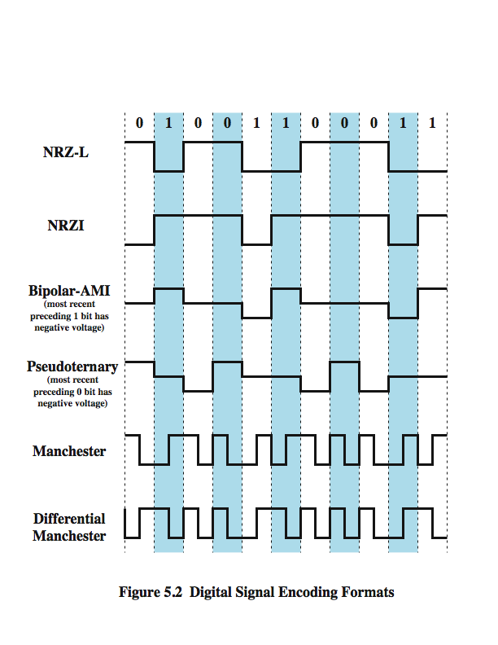
NRZ
NoReturn to Zero-Level (NRZ-L)
  Presence (0) or absence (1) ofvoltage
NoReturn to Zero, Invert on ones (NRZI)
  Presence (1) or absence (0) of a transition
  A differential encoding

Slide 8
Multilevel Binary
Uses more than 2 signal levels
Bipolar AMI
  No signal (0), positive pulse (1) and negative pulse (1)
Pseudoternary
  No signal (1), positive pulse (0) and negative pulse (0)

Slide 9
Biphase
Transition at the middle of bit period as clocking
Manchester
  Midbittransition for both clocking and data
  Low-to-high (1), high-to-low (0)
Differential Manchester
  Midbittransition only for clocking
  Transition at beginning of bit period(0), no transition at the beginning of bit period(1)

Slide 10
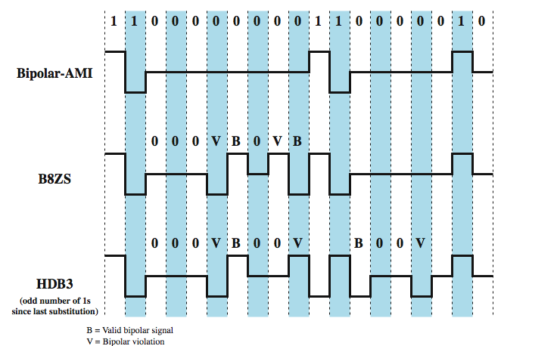
Scrambling schemes

Slide 11
Scrambling schemes(2)
Bipolar with8-ZerosSubstitution (B8ZS)
  Replace octets of all zeros with000+-0-+if the last pulse preceding the octet is positive
  Replace octets of all zeros with000-+0+-if the last pulse preceding the octet is negative
High-DensityBipolar3-zeros (HDB3)
  Replace strings of 4 zeros
 | Number of Bipolar Pulses (ones) since Last Substitution
Polarity of preceding pulse | odd | even
- | 000- | +00+
+ | 000+ | -00-

Slide 12
Desired Characteristics of Signal
No dc component
As many transitions as possible for synchronization
Noticeable difference in signal levels
Manageable range of frequency components to reconstruct the signal after transmission

Slide 13
Comparison
NRZ-L: difficult to synchronize sender and receiver
  E.g. bit string of all ones or all zeros
NRZ-I: synchronization still is problematic
  E.g. bit string of all zeros
NRZ is simple and low cost to implement
Multilevel Binary: cancels off dc component as much as possible by alternating sign of voltage levels
Manchester and Differential Manchester: clocking information is embedded in the signal itself

Slide 14
Digital Data, Analog Signal
e.g. 1) To produce analog signal of voice frequency range, to transmit over telephone network
2) to transmit digital data on an radio freq. carrier
Operates on one or more of
Amplitude,
Frequency and
Phase
of the carrier signal

Slide 15

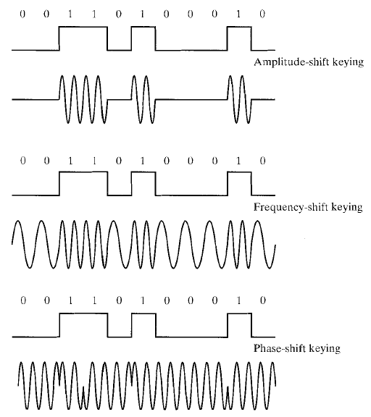
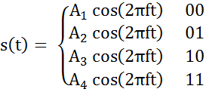
Amplitude Shift Keying (ASK)
Two amplitudes to represent two binary values
Multiple amplitudes for representing multiple bits

Slide 16

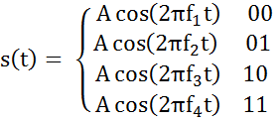
Frequency Shift Keying (FSK)
Two frequencies to represent two binary values (BFSK)
Multiple frequencies to represent multiple bits at a time (MFSK)

Slide 17

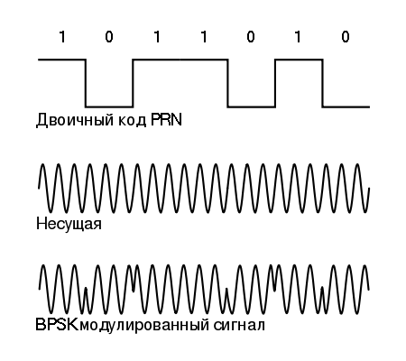
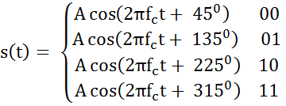
Phase Shift Keying (PSK)
Two phases to represent two binary values (BPSK)
Multiple phases to represent multiple bits

Slide 18
Analysis of A/F/PSK
One amplitude/frequency/phase per single bit gives a data rate equals to baud rate
Higher data rates
  Representing multiple bits with a single amplitude/frequency/phase
  n bits per amplitude/frequency/phase→ assign 2^n amplitudes/frequencies/phases for combinations
More different signals → More bits per baud
  Combine amplitude, frequency and phase shifts
Signals are represented in constellation diagram

Slide 19

Constellation Diagram
Amplitude (A) and phase shifts (α) of a given sinusoidal signal is plotted with dots
Each dot interprets a bit string
I: In-phase axis, Q:Quadratureaxis
Q-axis
1011
A
α
I-axis

Slide 20
QuadratureAmplitude Modulation
(QAM)
Q-axis
5
Combination of Amplitude and Phase Shifts
E.g. a set of signals is given in Figure 1
011
001
010
3
100
000
I-axis
110
111
101
Figure 1: constellation diagram

Slide 21
Analog Data,
Digital Data
The Digital Data may then be transmitted on a baseband or carrier signal

Slide 22
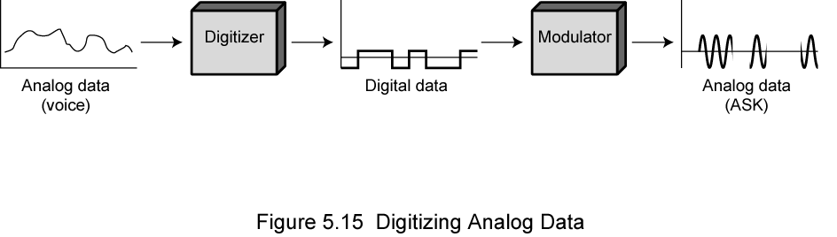
Introduction
Converting analog data to digital data (digitization)
Codec:converts analog data into digital form and recovers the original analog data from digital signal
Techniques used in codec
  Pulse Code Modulation (PCM)
  Delta Modulation (DM)

Slide 23
PCM – How to
Divide the amplitude range into levels
Assign each amplitude level a bit pattern ofnbits
Sample the analog signal periodically
Approximate the amplitude of each sample to the most closely matching level
111
.
.
.
001
000

Slide 24
Analysis of PCM
Accuracy of reconstructed signal
  Sampling rate?
  Number of amplitude levels?

Slide 25
Delta Modulation (DM)
analog input is approximated by a staircase function
  can move up or down one level ( ) at each sample interval
has binary behavior
  since function only moves up or down at each sample interval
  can encode each sample as single bit (1 for up or 0 for down)

Slide 26
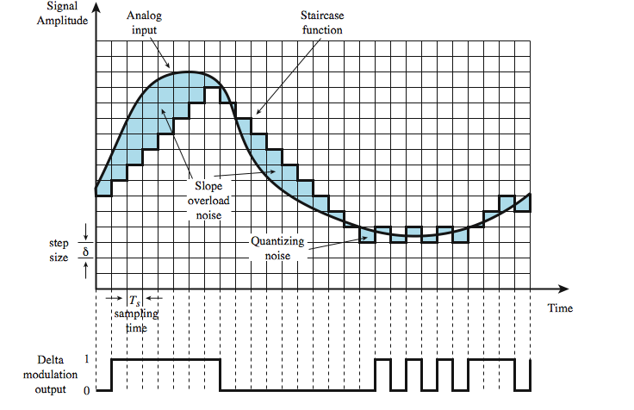
DM …continued

Slide 27
Analog Data, Analog Signal
Modulating signal
Modulated signal

Slide 28
Introduction
Moving a signal from its baseband to a different frequency band (Modulation)
Data is modulated on to a carrier wave
Principal techniques:
  Amplitude Modulation (AM)
  Angle Modulation
    Frequency Modulation (FM)
    Phase Modulation (PM)

Slide 29





Amplitude Modulation (AM)
where A(t) is the amplitude of the modulated signal, is the amplitude of the carrier signal is the modulation index
Modulator
Carrier component
Side bands
Acknowledgement: Prof. Dileeka Dias

Slide 30
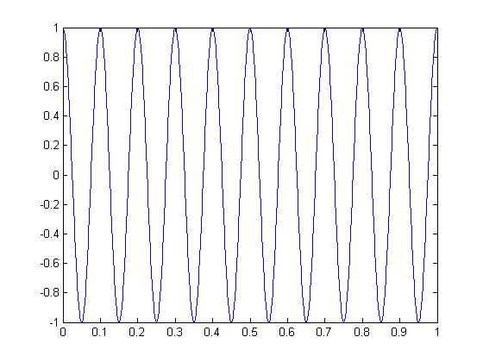
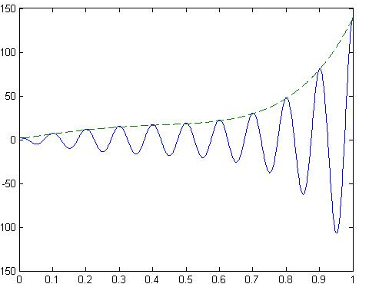
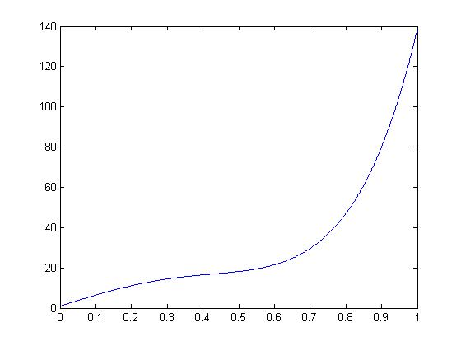
Example
Carrier signal
Modulated signal
Modulating signal

Slide 31

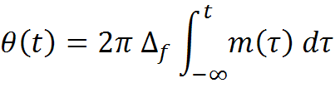

Angle Modulation
Modulated Signal
For Phase Modulation
For Frequency Modulation
Modulation index is the change of modulated variable with respect to the modulating signal
Acknowledgement: Prof. Dileeka Dias

Slide 32
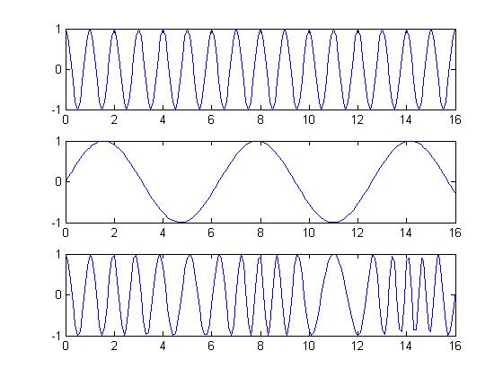
Frequency Modulation (FM)
Carrier
Modulating signal
Modulated signal

Slide 33
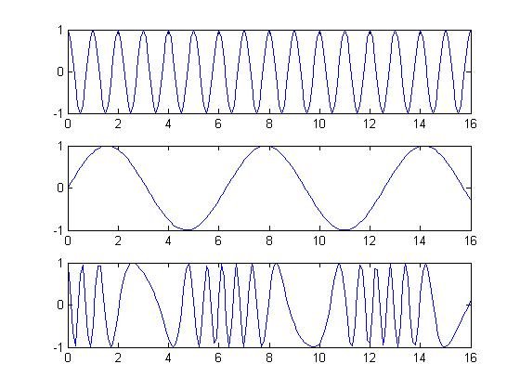
Phase Modulation (PM)
Carrier
Modulating signal
Modulated signal

Slide 34
Thank you

